Slide 1
CSC 204
Data Management and File Organizations
Prof. Mitchell, Computer Science Department
California State U., Sacramento
Fall 2007
File: P1_StorageSystemArchitectures204.ppt

Slide 2
Storage System Architectures
(Note: slides 2-13 are review of general-purpose I/O organization)
Physical System Component Interconnection – basic structure
1. Physical bus connects devices (disk, tape, terminal, printer, etc. and their controllers to CPU
2. CPU → cache memory → physical memory
+ memory management (MMU)
In the “old days”, a disk controller was a “card” (small logic board) with connectors to the disk device itself.
Now, disk units are much smaller and reliable, and a disk unit is a self-contained package, combining the physical medium, the micro-electronics and controller elements

Slide 3
A Bus is:
Sets of wires, or conduction media, or logic board traces used to connect multiple subsystems
A Bus in its many physical forms is also a fundamental tool for composing large shared communication links (and large multi-node DBs, too)
White: CPU bus; Gray: I/O bus
Processor
Input
Control
Memory
Datapath
Output

Slide 4
Layered functional and physical representation of a bus
The electronics and physics specifications
Transaction Protocol – order and rules of operation
Timing and Signaling Specification
Bunch of Wires inside cable or a ribbon,
Or, on board bus is a trace path
Electrical Specification
Physical / Mechanical Characteristics
– the connectors

Slide 5
I/O System – lowest level performs physical DB I/O
I/O processor structures, operations, and events
Device controllers (from device structure viewpoint) ← Bits and bytes level
- special-purpose processors
- local storage (aka buffer)
- registers
. control (write-only)
. data (read-write)
. status (read-only)
Instructions (from program/application viewpoint) ← I/O instruction streams
- read/write I/O addresses Ex: video memory
- registers in I/O controller might be addressable like normal memory
Interrupts (from system actions viewpoint) ← Interaction with rest of system
- device controllers can interrupt the CPU Ex: a disk I/O finished
- CPU can pole a device Ex: detect mouse position

Slide 6
I/O System Architectures
Interrupt Handling – modern systems are interrupt-driven
An interrupt is an “asynchronous request for service”
such requests happen at arbitrary (sometimes inconvenient) times
When an interrupt of process p occurs, the CPU
- preserves the current CPU state of p, including registers and PC
- forces execution of code (often called Interrupt handler) at “interrupt address”
- eventually, resumes p
Interrupt handlers (See slide ‘Interrupt-Driven Data Transfer’)
. perform requested service
. selective processing of other interrupts
(only higher priority interrupts will be handled while this handler runs)
. resumes interrupted program/code
(Interrupt-driven buffering systems are used extensively in DB runtimes,
especially for small-result queries; much more on this later)

Slide 7
3 I/O System Architectures
I/O operation – 3 approaches (used in systems as far back as ’70s):
1. Programmed I/O – an execution thread does “busy waiting” until an operation is completed
2. Interrupt-driven I/O – I/O command is issued for some process p,
but although p might need to wait for
command to finish, CPU can let other
process(es) p’ proceed;
Eventually p notified that command done
In either scheme, the CPU handles all I/O,
possibly very costly, considering disk I/O, network I/O and video I/O might all be involved; all this processing might be too slow, even for modern cpu clock rates, so
Thus, another I/O technique has been developed →

Slide 8
3 I/O System Architectures
3. Direct Memory Access (DMA)
- an alternative to above 2 approaches developed in 1970s, idea being:
special device “intervenes” between controller and system’s memory
- Operation
. CPU tells DMA controller
chunk size to be transferred
memory address where chunk to be stored
(both directions read/write possible)
. DMA controller
accesses device via its controller
transfers chunk(s)
- Benefits
. interrupts less frequent, but only to indicate chunk completion, and
avoid use of system bus (use I/O bus instead)

Slide 9
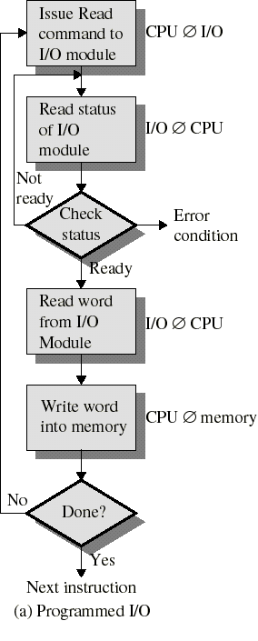
Programmed I/O - Review
Processor issues I/O command to I/O module
Processor continuously checks status of operation
In pictured scenario, CPU is much faster than device
CPU busy wait is wasteful

Slide 10
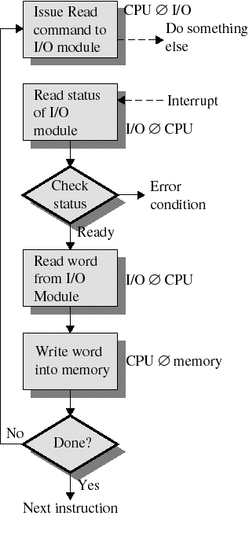
Interrupt Driven I/O - Review
CPU issues command to I/O module
CPU continues with other work (does not wait)
I/O module interrupts CPU when operation is complete
Repeated for each byte/block of data
Ex: keyboard character I/O

Slide 11
Interrupt-Driven Data Transfer
add
sub
and
or
nop
CPU
(1) I/O interrupt
happens here
user
program
(2) save PC and other context
Memory
IOC
(3) Start interrupt
service addr
read
store
...
rti
interrupt
service
routine
device
:
(4) Return from interrupt
memory
Advantage:
  User program progress is only halted during actual transfer
Disadvantage, special hardware is needed to:
  Cause an interrupt (I/O device)
  Detect an interrupt (processor)
  Save proper states and to resume-after-interrupt (rti instruction does this in step(4) of instruction-space diagram)

Slide 12
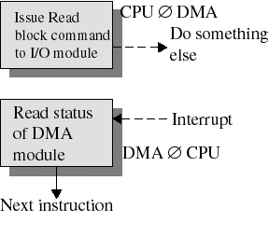
Direct Memory Access - Review
DMA device performs entire transfer into main memory
Interrupts the CPU when finished
CPU free to do other work during DMA transfer
More efficient than programmed or simple interrupt I/O
These days, DMA is used for network
related data transfers: Examples are: sftp, Web browser traffic, etc. and a NIC card is the interface
Also disk transfers often use DMA

Slide 13
Device variety
Amazing how many different kinds of devices computers deal with
Differences in I/O devices and their operational characteristics:
Data rate
Applications & relative importance per operation (priority)
Control complexity
Unit of transfer
Data representation
Error conditions and how errors handled
Device (2000) Purpose Partner Data rate (KB/sec) Mouse input human 0.02
Laser printer output human 100
Magnetic disk ← storage machine 50,000
Graphic display output human afap

Slide 14
System Architectures – Memory Management Hierarchy
Memory Management Hierarchically shown below - tradeoffs in red/italics:
  Smaller, more expensive storage “closer” to CPU
  Larger, less expensive storage “farther” from CPU
Primary storage: memory and MMU (volatile – if power lost)
- accessed directly using CPU load/store instructions
- instruction cost (in time units) for access to different elements:
  1 cycle (register), 3-15 cycles (depending on SRAM cache L1 or L2), 25 cycles (DRAM main memory)
  where time for 1 cycle = 1 / (cycles/sec)
  (1 X 10⁻⁹ sec = 1 nsec for 1 GHz CPU)
Secondary storage: Disks (non-volatile – if power lost)
- accessed via disk controller -100,000 times slower than a DRAM access !!
- supports random access to stored data, but non-uniform cost
Tertiary storage: Tapes (non-volatile – if power lost)
- now, typically used only for some backup and archive configurations
- vs. disk, very inefficient (thus, never used) for high rates of random access during query processing

Slide 15
Storage Hierarchy & locality principle
Hardware architecture Rationale
  Keep CPU as busy as possible
  Min system manufacture & usage costs (registers-only memory is too costly)
How it works
Levels: register, data cache, main memory, disk, tape silo … → paper
- caching: upon access, move data/instructions among hierarchy levels
- replacement (of some of a level’s capacity) when that level fills up
Why hierarchical storage works::
- Well-written programs exhibit reference locality – means successive instructions usually reference ‘nearby’ items:
Thus, after data/instructions referenced, then
data/instructions “near” them are likely to be referenced next
(Conclusion: if you write programs with wild addressing, modern
memory management hardware will penalize program’s performance;
same true for inefficient DB access )

Slide 16
DISK - Physical Structure and Operations
A stack of platters is mounted on a spindle (at geometric center)
- Spindle rotates platters past read/write (R/W) heads
- Heads are separated from platters by only a few microns
- Separation permits very fast rotation
approx. 300 (and it is slowly increasing over time) rotations/second
( Specification might be given in Revolutions Per Minute (rpm) )
- Magnetic fields induce electrical fluctuations in heads
(and vice-versa) & Strings of 0s and 1s read/written
Physical bit stream R/W technology has evolved to sophisticated code/decode schemes: FM → MFM → RLL → PRML → EPRML
Each platter organized as many concentric “tracks” (track numbers for controller)
- data is r/w to/from blocks (portions (= arc) of a track)
- all blocks on all platters having same track# constitute 1 cylinder (see next slide)
R/W head ----
| ----------------------------------------- Platter
R/W head ----
----------------------------------------- Platter
| (All R/W heads positioned at same track at given instant)
: ←Spindle

Slide 17
Magnetic Disk Operations
Track
Block
Cylinder: all the tracks under the head
at a given point on all surface
Read/write data is a multiple-step process:
  Seek time: re-position arm to desired track
  Rotational latency: wait for the desired block
  to rotate under the read/write head
  Transfer time: transfer a block of bits
  under the read-write head to computer memory
  (Also other steps, time costs vary – later slides)
Average seek time cited by the industry:
  Typically in the range of 3 ms (current fastest) to 8+ ms (older disks)
  Defined as: (Sum of the time for all possible seeks) / (total # of possible seeks)
Due to locality of disk reference, actual average seek time may:
  adjacent track seek approx. 0.5 sec, but ‘longest” seek might be 5msec
  (depends on physical disk geometry)
Cylinder
Platter
R/W Head

Slide 18
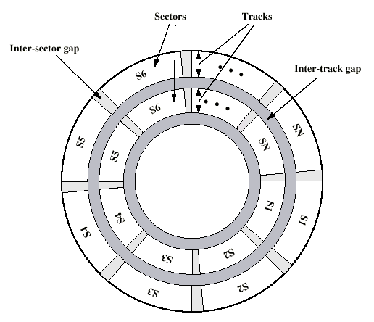
Disk surface – small-scale rendition NOTE: optimizations such as cylinder skew & block interleaving covered later

Slide 19
Disk Access Costs – operational characteristics
Disk access time consists of 5 time components =
  Seek time + Rotational latency time + controller overhead +
  transfer time + device queuing delays (depends on: OS and system load)
  {3rd and 5th terms ignored for purposes of this course, unless stated otherwise}
  Seek time (s): time to move disk arm (r/w head drive assembly) to specified track number (Note: 1 cylinder is largest storage amount on 1 disk that can be accessed with just 1 seek – See Text Fig 13.1) Unit: msec.
  Note: in a given situation we will use avg seek time over all disk accesses (unless otherwise indicated)
  Rotational latency (r): time needed for the referenced/needed block to rotate under the r/w head Unit: msec.
  Transfer time (tr): time to transfer some amount of data Unit: ? msec
  (Notes: s and r are the bottlenecks in disk I/O, and have always been so;
  For large transfers, transfer time might be the dominant term)
Other Interactions
- Disk scheduling should minimize number of s and r performed
(But, similar to elevator scheduling – several possible algorithms)
- Cache the file access results (as long as possible) to minimize disk Rs/Ws
(Note: On average, one W more expensive than one R on a disk)

Slide 20
Disk Access Costs – operational characteristics
In-class demo of hard disk operations:
P1_DiskOperation_demo.wmv

Slide 21
Storage System Architectures – Magnetic Tape
Tape
- mainly used as a backup device/medium
Ex: ECS major servers use tape backup of file systems,
(frequency being, essentially once per week)
- Very similar device to audio tape technology
- Sequential access to data
. R/W head moves past tape sequentially/linearly
. Once positioned, transfer is quite rapid
- Can store (with acceptable cost) n terabytes (= n*10¹² bytes)
of data on modern individual tape cartridge units
Highly-automated “tape farms” commercially available for 25 years; robotic arm selects tape unit to access in a silo, and
access time to a given cartridge (= tape) under 30 sec.
  Storage Technology Inc. is a typical commercial vendor

Slide 22
Storage System Architectures – Protection & Access Control
Memory and disks support concurrent usage, but tape does not
Goal: Prevent user processes/jobs from accidentally/maliciously damaging: OS structures and memory hierarchy it controls
  Parts of process memory space
  Other user’s process or device space
Storage Protection mechanisms deal with different aspects of damage:
- dual mode operation (needed by VMs): prevent user process taking over part of OS to tamper with another process or the OS itself
- privileged instructions: prevent user process interfering with another process (Ex: I/O is done by OS for users, not by users)
- memory protection: prevent user process directly accessing the address space of another user
- CPU protection via timers: prevent hanging the OS in an infinite loop or takeover by a rogue process
RDBMS combines OS file system protection and DB object protections

Slide 23
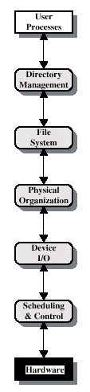
File System functional properties
Builds on top of a peripheral device, also includes:
Physical Organization
  Constructing files from physical locations on disk
File System
  Controlling user file operations
Directory Management
  Grouping files and operating on directories
  We have looked at lowest 3 levels so far…

Slide 24
Physical Organization aspects of file system done by OS
Manage main memory
- allocate/de-allocate memory to active processes (a process needs memory to exist); maintain map of allocated vs. free memory
- dynamically re-compact (aka de-fragment) memory
Manage secondary storage
- schedule access requests to disk
Devices
- device drivers; accept I/O request and invoke appropriate action
Files
- non-volatile (persistent over power loss) representation of programs and data
- file systems
. support logical organizations of data that are convenient for user
. map data to physical storage devices and implement access and updates
- operations
create, manipulate and delete files and directories
move files structures between memory hierarchy and secondary storage
backup and protection

Slide 25
Disk Layout (Details)
Because of disk geometry (concentric circles) there are more blocks at the outside edge of a disk surface
(Previous ‘Disk surface’ slide → suggests the idea of “zones”)
  Divide disk into zones, all tracks in a zone have the same number of blocks
  Outer zones have more blocks
  Modern disks 16, or more, “zones”

Slide 26
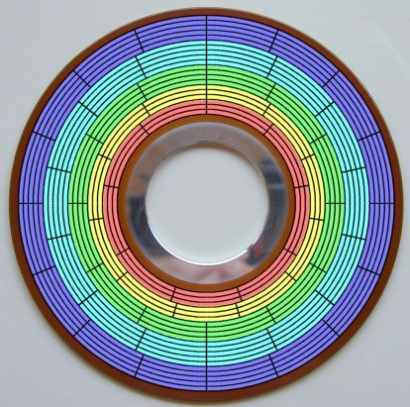
Zoned bit recording (ZBR)
ZBR illustration, different color per zone
A graphical illustration of zoned bit recording. This model hard disk has 20 tracks. They have been divided into five zones, each of which is shown as a different color.
The blue zone has 5 tracks, each with 16 sectors;
The cyan zone 5 tracks of 14 sectors each;
The green zone 4 tracks of 12 sectors;
The yellow 3 tracks of 11 sectors;
The red 3 tracks of 9 sectors.
You can see that the size (length) of a sector remains fairly constant over the entire surface of the disk Without ZBR, if the inner-most zone had its data packed as densely as possible, every track on this hard disk would be limited to only 9 sectors, greatly reducing capacity.

Slide 27
The 2 predominant Hard Disk Architectures
Disk contains number of tracks organized as concentric circles (many thousands of tracks per surface are typical now)
Tracks are subdivided into blocks
(Almost always block is 512 bytes →
the number of blocks per track depends on track size)
Disk may contain multiple surfaces
Disk head is positioned over a particular track
  Single head moves among tracks – Moving Head Drive (MHD)
  Assume MHD disk architecture rest of this course
  Multiple heads: One head per track (very expensive technology, thus rarely used) – Fixed Head Drive (FHD)
Disk rotates under the head
  Read data while disk platters spin
  Table 13.1 (p. 470) has examples of engineering specifications of typical disks (data > 5 years old – current fastest RPMs 17,500)

Slide 28
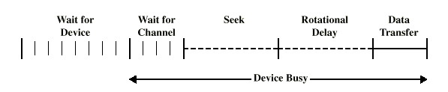
Data transfer term & overall r/w timing
  b – number of bytes to transfer
  N – number of bytes on a track
  r – time for 1 complete revolution
Rotational delay = (1/2)r
Transfer time = (b/N)r = time to copy from disk tracks to controller buffer; depending on configuration, additional time needed for cpu/disk bus connection transfer
  Below: Time sequence for 1 random R or 1 random W operation
  (more on the queuing later)
OS device queue

Slide 29
Physical disk Formatting
SKIP To Slide #33 for now
Disk comes blank
Format defines layout of data
  Preamble: special bit pattern (start of block)
  Data: typically is 512 bytes
  ECC: Error correction code (16 bytes typical)
Master boot record (on block 0, if this is a boot device)
  Contains boot code
High level format initial format result:
  Boot block, root directory, and empty file system
  The Data section in diagram represents the bytes of storage available for system/user directories, files, records
Disk block
Data
Preamble
ECC

Slide 30
Cylinder Skew optimization within one zone
Offset of block 0 on track n vs. block 0 on track (n-1)
Time is required to seek head to adjacent track
  Head would pass first block without an offset
  Ex: After reading content of successive blocks on the outer track shown, then a seek to the inner track should position close to block 0 (the line in the diagram)
  Technique has become obsolete on modern disks whose controllers are much faster (bigger buffers and transfer rate)
13
14
12
15
0
15
14
1
11
13
2
0
10
12
3
1
9
11
4
2
8
10
5
3
9
6
7
8
7
4
6
5

Slide 31
block Interleaving optimization
Time is needed to transfer a buffered block of data to the controller
  During this time disk head will pass the next block
  Solution: interleave blocks
  As with skew, not a significant feature of modern disks
No Interleaving
Single Interleaving
Double Interleaving
7
0
7
0
5
0
6
1
3
4
2
3
5
2
6
1
7
6
4
3
2
5
4
1

Slide 32
Contiguous vs. Random data – comparing access time
Compare 2 different ways to access the same data set “D”:
Sequential – all of D is as close together (aka “contiguous”) as disk can allow
Contiguous has 2 meanings:
. all of D on 1 cylinder (if D occupies less than 1 cylinder)
. All of D on adjacent cylinders (if D is too big for 1 cylinder)
Random – parts of D are placed on separated track groups (instead of adjacent ones)
Next slide uses data from recent disk parameters, but relative speed of sequential vs. random access will always hold for older disks as well as the fastest modern ones

Slide 33
Disk data placement effects on Performance
Compare contiguous vs. scattered access time for data set D = 256 blocks
avg(s) | Rotation delay | Track transfer time | Blocks per track
5 msec | 2 msec | 4 msec Based on 15000 rpm | 32 ← makes calculations simpler; modern disks can have nX1000 blocks/track
256 block file stored contiguously within one cylinder on 8 different surfaces
Number of tracks = 8; mem buffer = 32 blocks
Total time = seek + 8*(Track process time)
Track process time = Rotational Delay +
Track Read time
= 2 + 4 = 6 ms
Total time = 5ms + 8*6ms
= approx. 53 ms
256 blocks, each on a random track
Total time = 256 * (Block process time)
Block process time = Seek + Rotational Delay + Block Read time
= 5 + 2 + .12 5
= 7.125 ms
Total time = 256 * 7.125ms
= approx 1825 ms (approx. 40 times slower vs. contiguous)
?
. Only one seek overhead, then 8 tracks read from 8 surfaces (all data on same cylinder); surface switch time ignored
Rotational delay once for every
32 blocks & skew optimization assumed
Seek and rotational delay for
every block, resulting in worst-possible time for reading 256 blocks

Slide 34
Modern disk architecture performance parameters
. The rpm characteristic for disks is now 15,000-17500 rpm depending on manufacturer and model
. These higher rpm values minimize the need of sector interleaving
Also, on-device and cpu main memory storage areas, aka buffers, are now very large compared to years ago;
It was common in the past to have buffer size = 1 disk block, but, now buffer size = 1 track (or even larger)
Today’s faster busses allow trading of larger transfers vs. time to rotate once: now configure to do I/O in large units, one track, or larger
. Thus, nowadays, s and r and large buffers determine disk performance for a lightly loaded disk (assuming I/O wait queue usually empty)
See Table 13.3, p. 498 for summary of disk technology advancements

Slide 35
Disk Scheduling Policies
Schedule disk accesses to minimize seek and rotational overhead (Applicable to single or multiple file access) Here are example policies and summary of their behaviors:
First in First Out (FIFO)
  Fairest Policy, but approximates random
Last in First Out (LIFO)
  Favor recent requests
  Try to process grouped requests
Shortest Service Time First (SSTF)
  Minimizes average seek time
  May starve outlying tracks

Slide 36
Disk Scheduling Policies (continued)
Scan (Elevator scheme)
  Scan head across disk in both directions (back and forth)
  Means: starting at track#0 (or at the pending request with smallest track#), service all pending requests at track#j greater than current track# in increasing track# order, and continue until no more requests with larger track#;
  then, reverse the scan direction by
  starting with track#max (or at the pending request with the largest track#), service all pending requests at track#j smaller than current track# in decreasing track# order, and continue until no more requests with smaller track#
  Good performance
C-Scan
  Scan head from lower-to-larger track #s
  Reset to first track after doing last in current scan
Priority
  Schedule based on process priority
  Does not try to minimize disk access overhead,
  thus, next service is to a highest priority waiter
Analogous to a raster scan on display devices (sweep in one direction, reset and sweep again

Slide 37
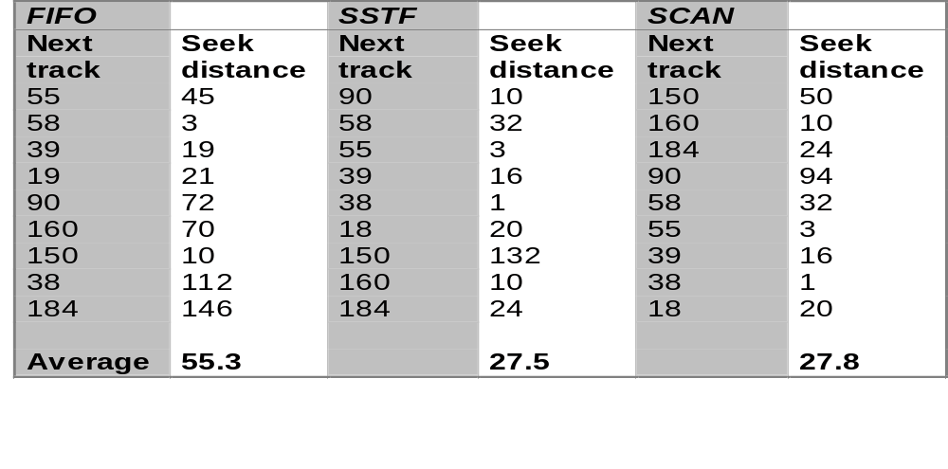
Scheduling Policy Comparisons
FIFO (First In First Out) performs the worst
SSTF (Shortest Seek Time First) performs the best, but starvation possible
SCAN (Scan=continue in same direction) performs well, avoids starvation – justifies why scan variations done in practice
Example below: Same 9 track#s visited, but in different order, depending on the scheduling method
Assume initial track =100 and request order: 55,58,39,19,90,160,150,38,184

Slide 38
A live Demo of disk operations
On class web home page, there is a demo (in windows media format) lasting approximately 2.5 minutes, that demonstrates physical disk operation
If you cannot run the demo directly from the web home page, then download it to a hard drive and run
P1_DiskOperation_demo.wmv

Slide 39
Disk Cache aspect of cache -- memory hierarchy
RAID for I/O parallelism
Main memory set aside for frequently referenced disk blocks (technique that Oracle and other RDBMSs use)
  Each DBMS uses MMU + caching + proprietary DBMS optimizations
Can support sophisticated memory hierarchy replacement policy
  Least Frequently Used (LFU)
  Least Recently Used (LRU)
  Other
  Realizing throughput limitation of max(random I/O)/sec for one disk,
  cover (in more detail later) the RAID approach to disk storage –
  Replace bad disks on-the-fly;
  Parallelize (physically) the r/w operations so that R/W operations occur on several disks simultaneously – recall limitation that one modern disk can do approx. 150 random I/Os per second;
  In mid 1990s, RAID became reliable and cost-effective (Ch 13, sec 10)

Slide 40
Server Structure – different ways to serve users
Configuring (OS+DB) as server in Client+server architecture
1. Single server: Each user process pi interacts with 1 copy of server
2. Many servers: n servers, and each pi connects to and interacts with one of the n
3. Serve yourself: n servers booted; each pi boots and uses one server
and the user can switch (for load balancing) between them, as desired
Peer-to-peer family of cooperating systems – each CPU is autonomous and each runs an OS that has a subset of services in common with all of the others (for cooperative distributed computing)
Unless stated otherwise, ASSUME ARCHITECTURE IS: Single server, and the client side issues DB access requests and receives results;
we usually ignore the effects of congested disk I/O queuing and
irregular delays caused by a very busy server (= 5th term on slide titled ‘Disk Access Costs – detailed operational characteristics’

Slide 41
A note on disk vs. relational DBMS
One of the aims of the relational DB model is to insulate the user/applications from physical disk details and operations
(Example: when coding SQL queries, the user does not need to be aware of I/O methods, searches, structures
-- The inventor of the relational model prohibited SQL from exposing internal level & device specifics)
For example, the SQL DML rarely requires a user to code descriptions about physical storage, but there are some obvious exceptions;
Example: A user might want to specify that data for a particular table is stored (for performance reasons) on a specific disk or disk array
In Oracle: create table …
clause specifying a TableSpace

